Slide 1
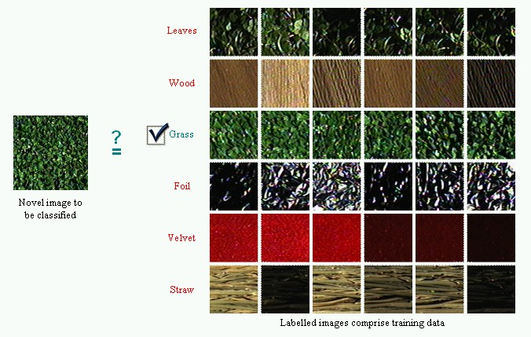
Texture Recognition
To automatically classify and identify textures and patterns in images

Slide 2
Outline
Problem
What is LBP?
How LBP works?
Implementation
Training
SVM (Classification)
Why LBP?
References

Slide 3
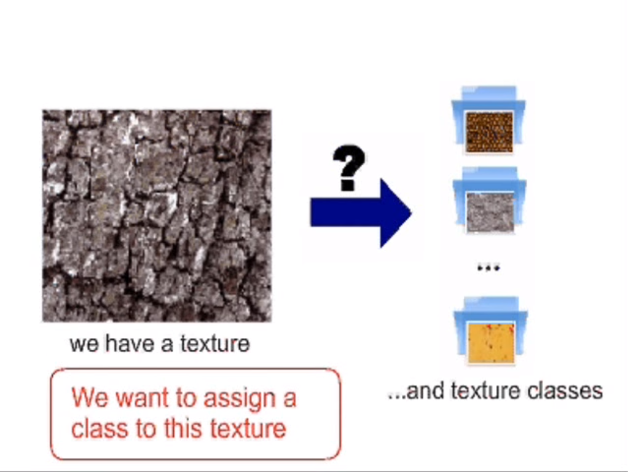
Problem

Slide 4
So we need a representation model for texture
Local Binary Pattern
Local binary patterns (LBP) is a type of visual descriptor used for classification in computer vision.
LBPs compute a local representation of texture.
It is an image operator which transforms an image into an array or image of integer labels describing small-scale appearance (textures) of the image.
Notes:
This local representation is constructed by comparing each pixel with its surrounding neighborhood of pixels.

Slide 5
How does it works?
The first step in constructing the LBP texture descriptor is to convert the image to grayscale.
For each pixel in the grayscale image, we select a neighborhood of size r surrounding the center pixel.
A LBP value is then calculated for this center pixel and stored in the output 2D array with the same width and height as the input image.
We then convert this binary string to decimal, yielding a corresponding value.

Slide 6
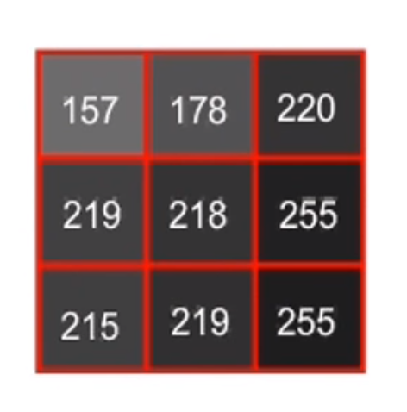
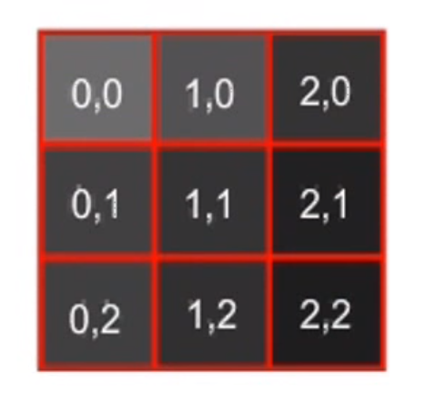
00111101
= 61
Local binary pattern for pixel (1,1)
Pixel Values
3 X 3 neighbourhood
This process of thresholding, accumulating binary strings, and storing the output decimal value in the LBP array is then repeated for each pixel in the input image. So, we store count of each LBP for this texture.
Notes:
In the above figure we take the center pixel (highlighted in red) and threshold it against its neighborhood of 8 pixels. If the intensity of the center pixel is greater-than-or-equal to its neighbor, then we set the value to 1; otherwise, we set it to 0. With 8 surrounding pixels, we have a total of 2 ^ 8 = 256 possible combinations of LBP codes.
we need to calculate the LBP value for the center pixel. We can start from any neighboring pixel and work our way clockwise or counter-clockwise, but our ordering must be kept consistent for all pixels in our image and all images in our dataset.
Given a 3 x 3neighborhood, we thus have 8 neighbors that we must perform a binary test on. The results of this binary test are stored in an 8-bit array, which we then convert to decimal, like this:

Slide 7
Implementation
We first need to create a dataset of textures.
Given a dataset, our goal is to extract Local Binary Patterns from these images and apply machine learning to automatically recognize and categorize these texture images.
LBPs require two parameters: the radius of the pattern surrounding the central pixel, along with the number of points along the outer radius, so we initialize these values.

Slide 8
4) The lbp variable returned by the local_binary_patterns is a 2D array with the same width and height as our input image.
5) To construct the actual feature vector, we count the number of times each of the LBP prototypes appears and construct a histogram. We then take this histogram and normalize it such that it sums to 1.
6) We’ll initialize two lists: data to store the feature vectors and labels to store the names of each texture.

Slide 9
Training

Slide 10
We now loop over our training images. For each of these images, we load them from disk, convert them to grayscale, and extract Local Binary Pattern features. The label (i.e., texture name) is then extracted from the image path and both our labels and data lists are updated, respectively.
Once we have our features and labels extracted, we can train our Linear Support Vector Machine to learn the difference between the various texture classes.
Once our Linear SVM is trained, we can use it to classify subsequent texture images.

Slide 11
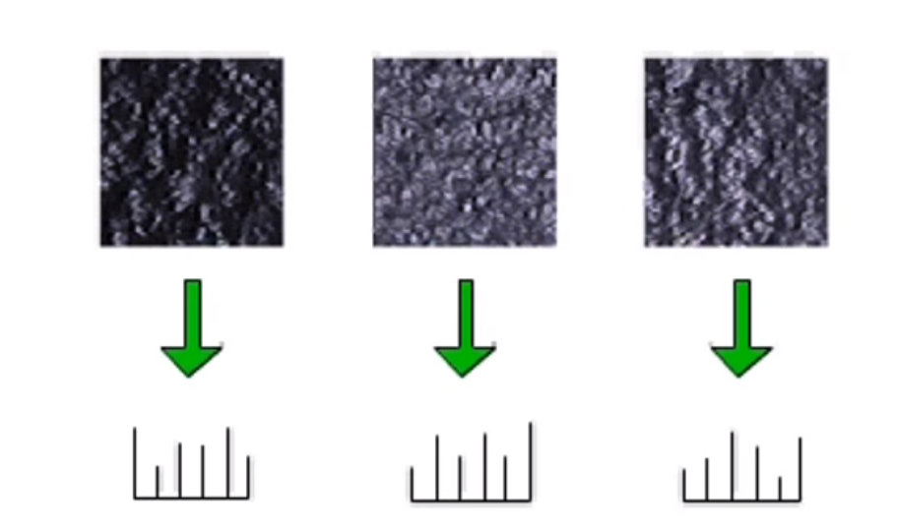
We select a number of texture from a class called training data.
Converted to grayscale.
Convert them to their model(LBPs)

Slide 12
Support Vector Machine

Slide 13
A SVM model is a representation of the examples as points in space, mapped so that the examples of the separate categories are divided by a clear gap that is as wide as possible.
Given a set of training examples, each marked as belonging to one or the other of two categories, an SVM training algorithm builds a model that assigns new examples to one category or the other.
New examples are then mapped into that same space and predicted to belong to a category based on which side of the gap they fall.

Slide 14
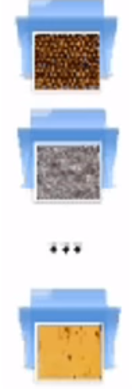
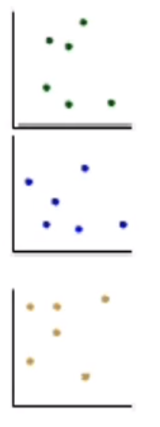
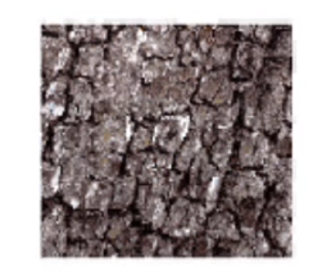
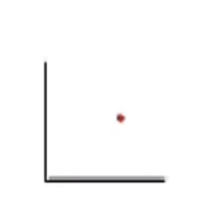
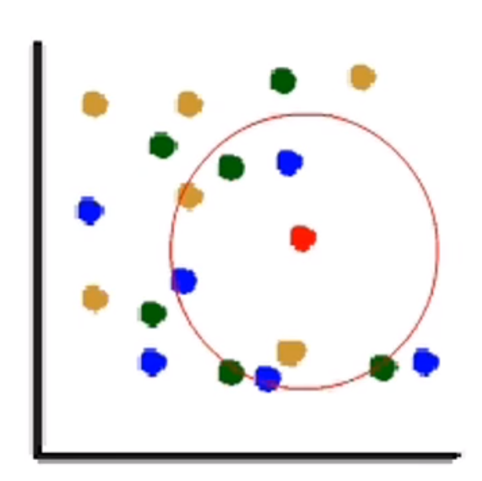
So we have a texture
(a point)
And a texture class
(set of points)
We will find the k nearest neighbour to point red
The nearest points are from blue class
So, we assign that respective class to the query texture

Slide 15
Why LBP?

Slide 16
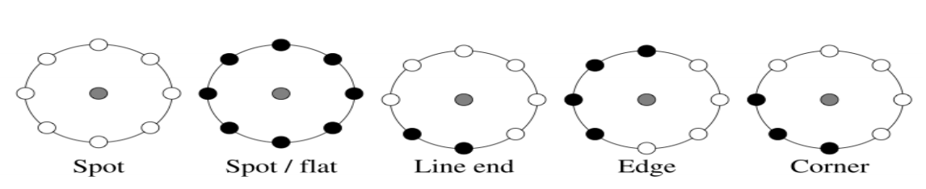
Robustness to monotonic gray-scale changes caused, for example, by illumination variations.
Computational simplicity, which makes it possible to analyze images in challenging real-time settings.
Different texture primitives can be easily detected by its simple algorithm.

Slide 17
References
https://www.youtube.com/results?search_query=local+binary+pattern+feature+extraction+for+texture+recognition
https://www.hindawi.com/journals/isrn/2013/429347/
https://www.researchgate.net/figure/Different-texture-primitives-detected-by-the-LBP_fig3_251202290
https://www.ijert.org/research/survey-on-extraction-of-texture-based-features-using-local-binary-pattern-IJERTV4IS070328.pdf

Slide 18
Questions?

Slide 19
Thank You

